Slide 1
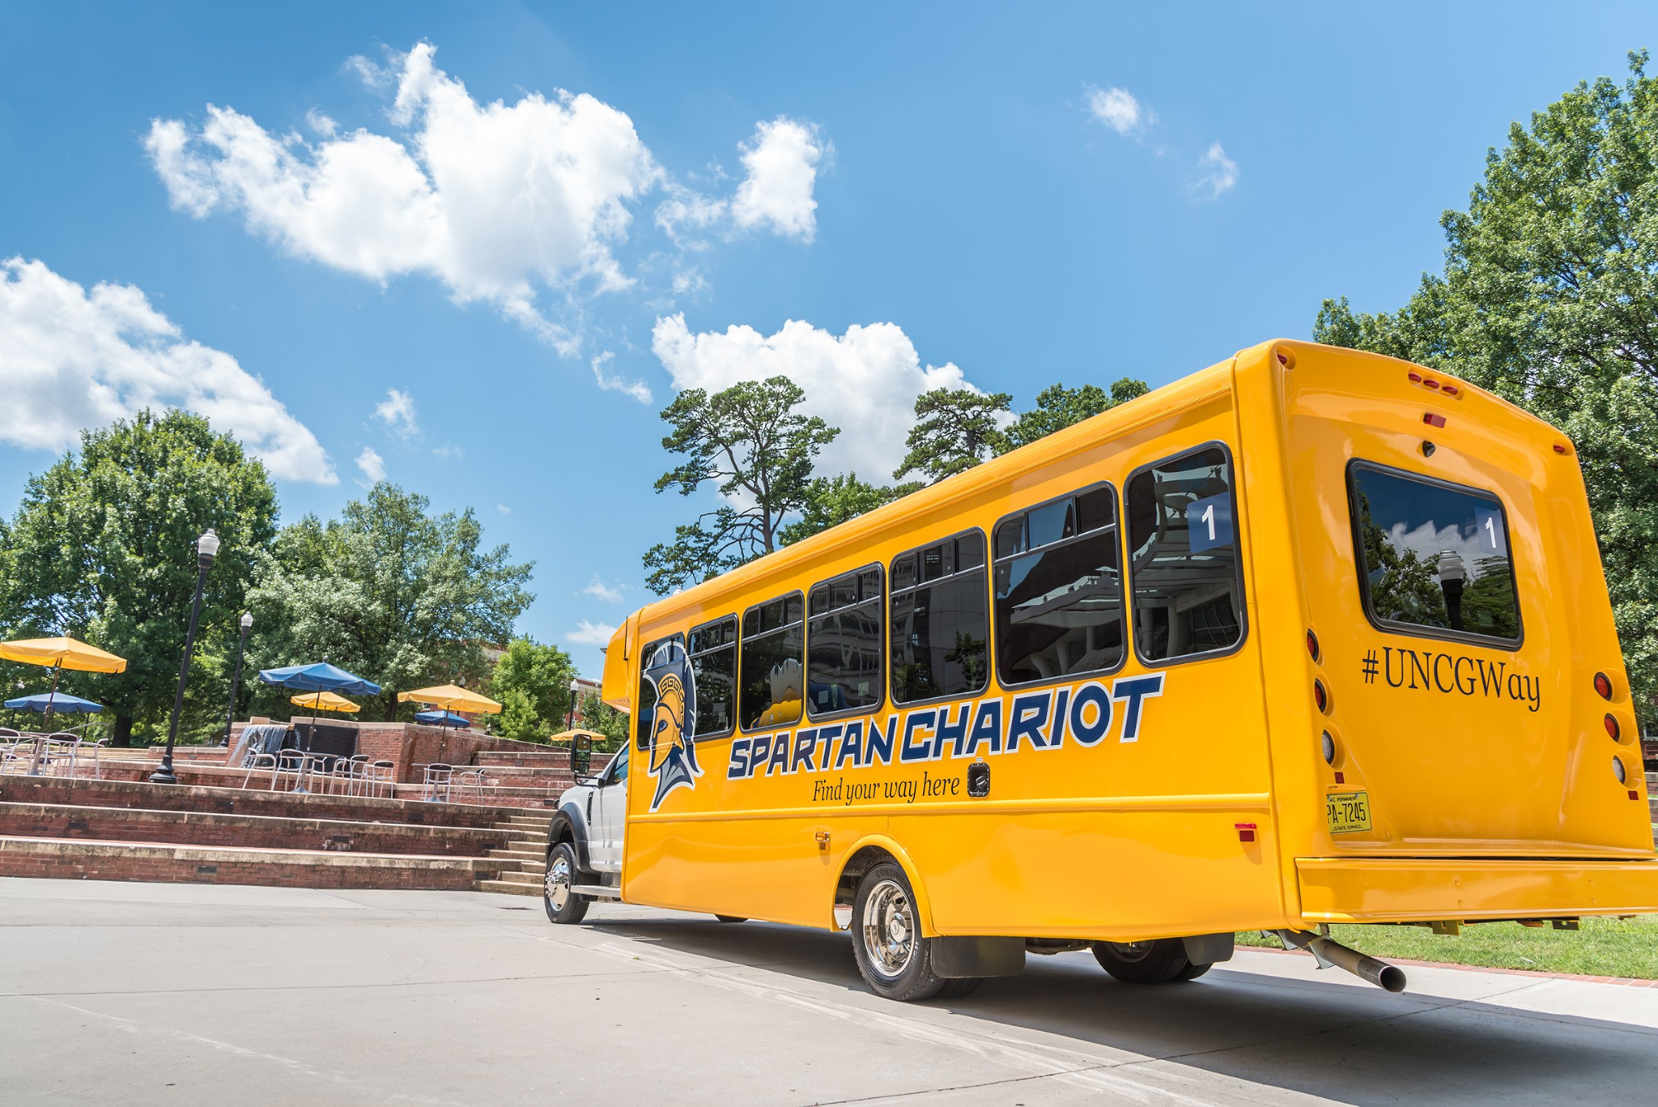
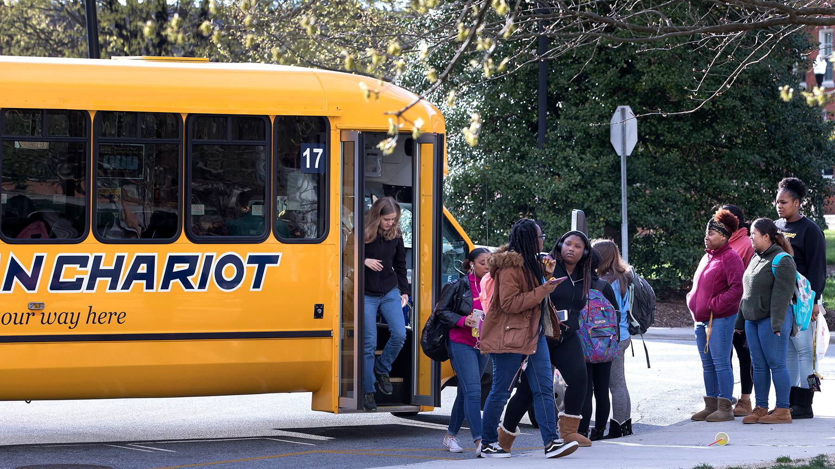
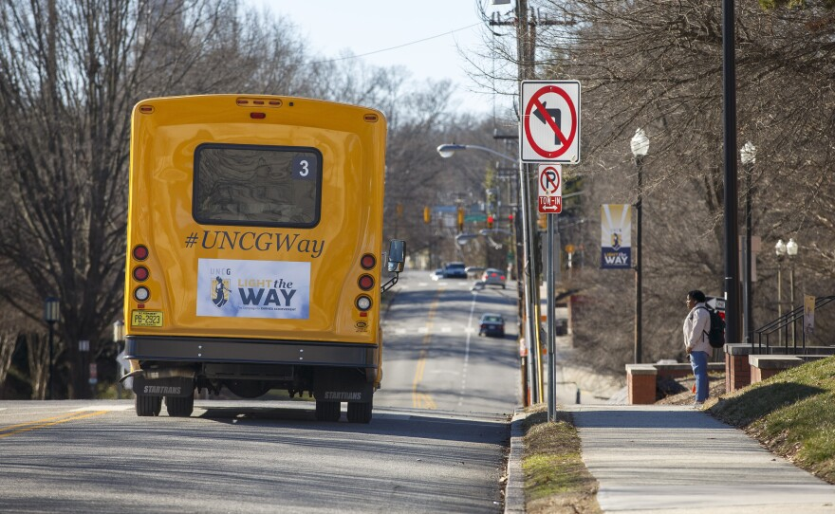
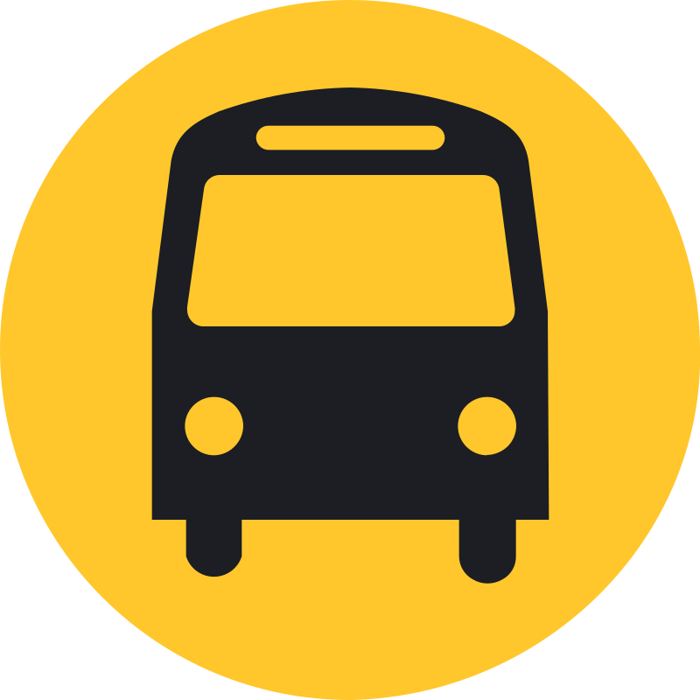
GoChariot
A UNCG Spartan Chariot Tracking system redesign
Logan Phillips, Hasan Hashim, Madelyn Good

Slide 2
Overview
The GoChariot project aims to revolutionize how UNCG students, staff, and visitors navigate campus by offering a comprehensive, user-friendly Spartan Chariot tracking system.
Current Spartan Chariot tracking lacks safety features, communal features, and is not user-friendly to navigate. GoChariot addresses these issues by having a modern user interface, user feedback, and enhanced safety features.
Key Features of GoChariot:
"Real-time bus route tracking"
"Ride request and scheduling for students"
"Driver review system"
"Safety alerts for immediate dissemination"
"Admin panel for managing users and bus routes"

Slide 3
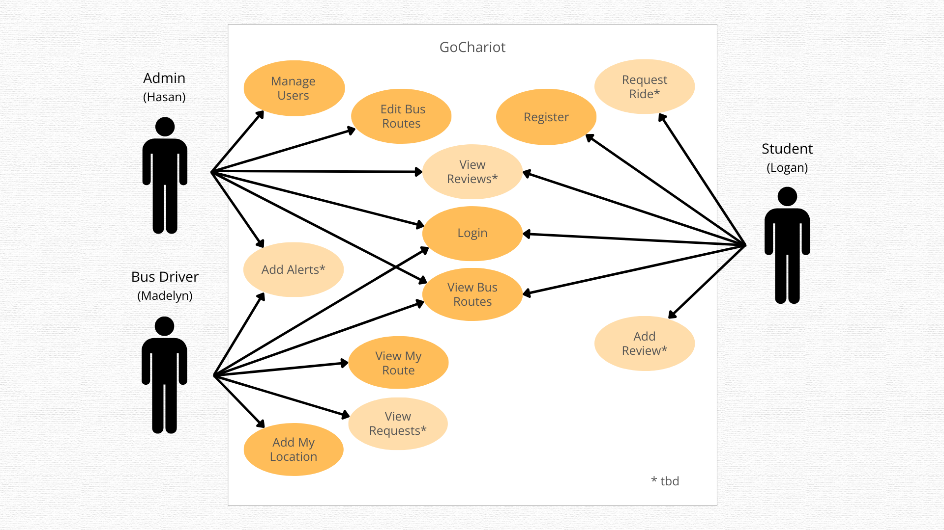

Slide 4
Student Interface (Logan Phillips)
Login & Register: Students can easily access their GoChariot accounts to manage their transportation needs.
View Bus Routes: A live map shows all active Spartan Chariots, helping students plan their journeys.
Request Ride & Add Review: Students can request rides to their desired destinations and provide feedback on their experiences.

Slide 5
Driver Interface (Madelyn Good)
View My Route: Drivers have access to their daily routes and schedules for efficient planning.
Add My Location: Real-time location updates help students track the Chariot's exact position.
View Requests & Add Alerts: Drivers can view ride requests and send out alerts for any delays or issues.

Slide 6
Admin Interface (Hasan Hashim)
Manage Users & Edit Bus Routes: Admins can add or remove users and modify bus routes to improve service.
View Reviews & Add Alerts: Admins have the ability to monitor driver performance through reviews and issue campus-wide alerts.

Slide 7
Live Demo
https://gochariot.co/

Slide 8
Source Code
https://github.com/logashton/logashton.github.io

Slide 9
Questions ?

